Slide 1

Moderator :
Alukwe -
+254720474923|+254780474923
cakhonya@kabarak.ac.ke alukchris@gmail.com

Slide 2
Information Systems Audit.
FIC4030 A
Day & Time:
Saturday
09:00am – 12:00hrs

Slide 3
Performing a Risk Assessment
Lecture 5
Systems Audit & Fraud

Slide 4
Introduction
Companies face four types of threats to their information systems:
  Natural and political disasters
  Software errors and equipment malfunction
  Unintentional acts
  Intentional acts (including computer crime)
Notes:
Ch 5

Slide 5
Fraud Defined
Fraud is any and all means a person uses to gain an unfair advantage over another person.
Typically, a fraudulent act must involve:
  A false statement
  A material fact
  Knowledge
  Reliance
  Injury or loss
Notes:
Ch 5

Slide 6
Fraud Defined
Three types of fraud:
  Misappropriation of assets
  Corruption
  Fraudulent statements
Notes:
Ch 5

Slide 7
The Auditor’s Responsibility to Detect Fraud requires auditors to:
  Understand fraud
  Discuss the risks of material fraudulent misstatements
  Obtain information
  Identify, assess, and respond to risks
  Evaluate the results of their audit tests
  Communicate findings
  Document their audit work
  Incorporate a technology focus
Notes:
Ch 5

Slide 8
Who Commits Fraud and Why
White collar criminals
Violent criminals
Hackers
Computer fraud perpetrators
Notes:
Ch 5

Slide 9
The Fraud Triangle
Pressure
Opportunity
Rationalization
Action of attempting to explain or justify behavior or an attitude with logical reasons, even if these are not appropriate
Notes:
Ch 5

Slide 10
The Fraud Triangle: Pressures
The most common pressures were:
  Financial
    Not being able to pay one’s debts, nor admit it to one’s employer, family, or friends
    Business reversals
  Emotional
    Fear of loss of status
    Physical isolation
    Difficulties in employer-employee relations
  Lifestyle
    Status gaining
    Drug/alcohol addiction
    Gambling
Notes:
Ch 5

Slide 11
The Fraud Triangle: Pressures
Common pressures in financial statement fraud includes the need to:
  Prop up earnings or stock price OR to reduce earnings
  Cover the inability to generate cash flow
  Obtain financing
  Appear to comply with bond covenants or other agreements
Notes:
Ch 5

Slide 12
The Fraud Triangle: Opportunity
Opportunity is the opening or gateway that allows an individual to:
  Commit the fraud
  Conceal the fraud
    Expensing
    Lapping
    Kiting
  Convert the proceeds
Notes:
Ch 5

Slide 13
The Fraud Triangle: Opportunity
Common opportunities that enable fraud:
  Lack of internal controls
  Failure to enforce controls
  Excessive trust in key employees
  Incompetent supervisory personnel
  Inattention to details
  Inadequate staff
Notes:
Ch 5

Slide 14
The Fraud Triangle: Opportunity
Internal controls that may be lacking or un-enforced include:
  Authorization procedures
  Clear lines of authority
  Adequate supervision
  Adequate documents and records (policy documents)
  A system to safeguard assets
  Independent checks on performance
  Separation of duties
Notes:
Ch 5

Slide 15
The Fraud Triangle: Opportunity
Management may allow fraud by:
  Not getting involved in the design or enforcement of internal controls;
  Inattention or carelessness;
  Overriding controls; and/or
  Using their power to compel subordinates to carry out the fraud.
  (Do self-paced study on causes of Rationalization)
Notes:
Ch 5

Slide 16
The Fraud Triangle: Summary
Fraud occurs when:
  People have perceived, non-shareable pressures;
  The opportunity gateway is left open; and
  They can rationalize their actions to reduce the moral impact in their minds (i.e., having low integrity).
Fraud is much less likely to occur when
  There is low pressure, low opportunity, and high integrity.
Notes:
Ch 5

Slide 17
Computer Fraud
Computer fraud is any illegal act for which knowledge of computer technology is essential for its perpetration, investigation, or prosecution
What are examples of computer fraud?
  unauthorized use, access, modification, copying, and destruction of software or data
  theft of money by altering computer records or the theft of computer time
  theft or destruction of computer hardware
  use or the conspiracy to use computer resources to commit a felony
  intent to illegally obtain information or tangible property through the use of computers
Notes:
Ch 5

Slide 18
Computer Fraud Overview
Computer fraud is what triggers Forensic Investigations.
Computer Forensic Investigation Is;
The process of detecting hacking attacks and properly extracting evidence to report the crime and conduct audits to prevent future attacks.
It is simply the application of computer investigation and analysis techniques in the interests of determining potential legal evidence.
Notes:
Ch 5

Slide 19
Computer Fraud Overview cont…
Evidence might be sought in a wide range of computer crime or misuse, including but not limited to;
Theft of trade secrets,
Theft of or destruction of intellectual property and
Fraud.
Investigators can draw on an array of methods for discovering data that resides in a computer system, or recovering deleted, encrypted, or damaged file information.

Slide 20
Computer Fraud Overview cont…
When is Forensics & Ethical Hacking Required? (Computer Security)
When we Have;
Disloyal employees.
Computer break-ins.
Possession of pornographic Materials on the N/w
Breach of contract Btwn Employers & Employees
Industrial espionage. (Spying directed towards discovering secrets of rival co.)
E-mail Fraud.
Bankruptcy within banks and institution.
Disputed dismissals.
Web page/Web Communication defacements/attacks.
Theft of company documents..etc

Slide 21
Legal and Ethical Implications Trending in Computing in Todays Workplace.
Computer Fraud Overview cont…
Case Study Scenarios
Hacking & Frauds of Banking & Financial Systems
Countermeasures

Slide 22
Computer Fraud Overview cont…
Samples of Emerging Crimes
Watch the following Videos;
Hacking ATM Machines.
https://youtu.be/ZVmlxBFoYwc
Hacking The Systems Episode 1.(Live play)
Social Engineering by impersonation.

Slide 23
Trending attacks
https://gulfnews.com/technology/serial-hacker-is-back-26-million-users-personal-data-for-sale-1.1552987721417
https://www.standardmedia.co.ke/ureport/article/2001311340/dci-publishes-list-of-suspected-bank-hackers
https://www.kenyans.co.ke/news/61854-health-cs-kagwe-ends-meeting-abruptly-after-security-breech
https://www.kenyans.co.ke/news/37461-jkuat-student-hacks-local-bank-steals-ksh41m
https://cisomag.eccouncil.org/uk-cops-becoming-ethical-hackers/
https://www.businessdailyafrica.com/news/Top-law-firms-caught-up-in--Sh450m-CBA-loans-fraud/539546-4625274-6ej371/index.html

Slide 24
Why Should one Consider Computer/Cybersecurity as a Profession
Computer Fraud Overview cont…
http://blog.indeed.com/2017/01/31/trending-jobs-across-the-world/
https://www.itjobswatch.co.uk/jobs/uk/cyber%20security.do#job_vacancy_trend
http://breachlevelindex.com/
https://cybersecurityventures.com/hackerpocalypse-cybercrime-report-2016/
https://www.prnewswire.com/news-releases/global-cybersecurity-workforce-shortage-to-reach- 18-million-as-threats-loom-larger-and-stakes-rise-higher-300469866.html
https://www.csoonline.com/article/3120998/techology-business/zero-percent-cybersecurityunemployment-1-million-jobs-unfilled.html
https://www.payscale.com/research/US/Job=Cyber_Security_Engineer/Salary

Slide 25
Computer Fraud Overview cont…
Potential Beneficiaries to Computer security/ Absorption Fields
Police and other law enforcement personnel.
Defense and Military personnel.
E-Business Security professionals
Systems administrators
Legal professionals.
Banking, Insurance and other professionals
Government agencies
IT managers

Slide 26
Types of Hackers
Computer Fraud Overview cont…
Types of Hackers.
A black hat hacker (or black-hat hacker) is a hacker who "violates computer security for little reason beyond maliciousness or for personal gain"
A white hat hacker is a computer security specialist who breaks into protected systems and networks to test and asses their security. White hat hackers use their skills to improve security by exposing vulnerabilities before malicious hackers (known as black hat hackers) can detect and exploit them.
Grey hat, alternatively spelled as "greyhat" or "gray hat", refers to a computer hacker or computer security expert who may sometimes violate laws or typical ethical standards, but does not have the malicious intent typical of a black hat hacker.
Suicide hackers – Suicide hackers are those who hack for some purpose and even don’t bother to suffer long term jail due to their activities. They can be bad as well as good

Slide 27
Common Methods in Protecting systems
Computer Fraud Overview cont…
Patching
Anti viruses
Bit lockers.
Encryptions etc.
IDS

Slide 28
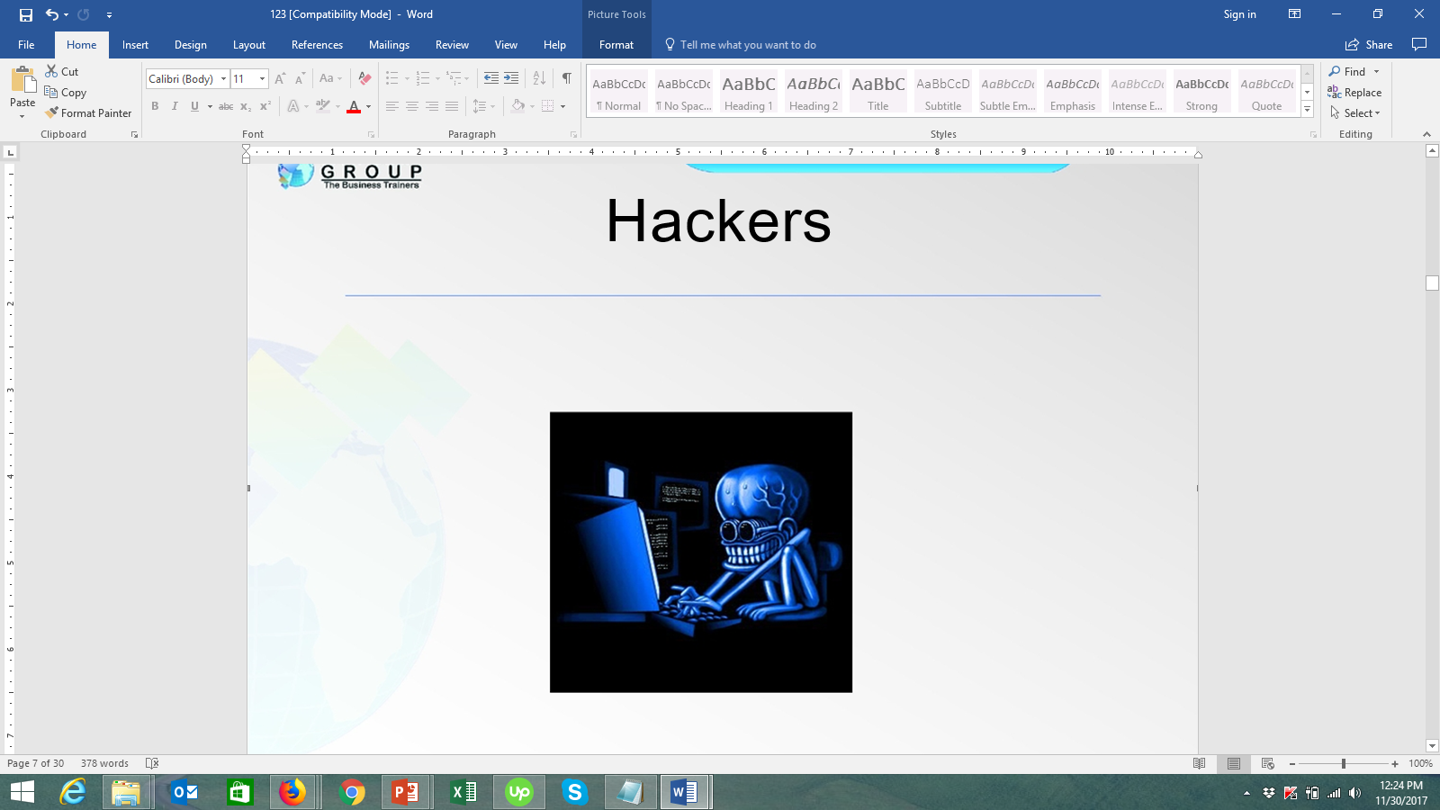
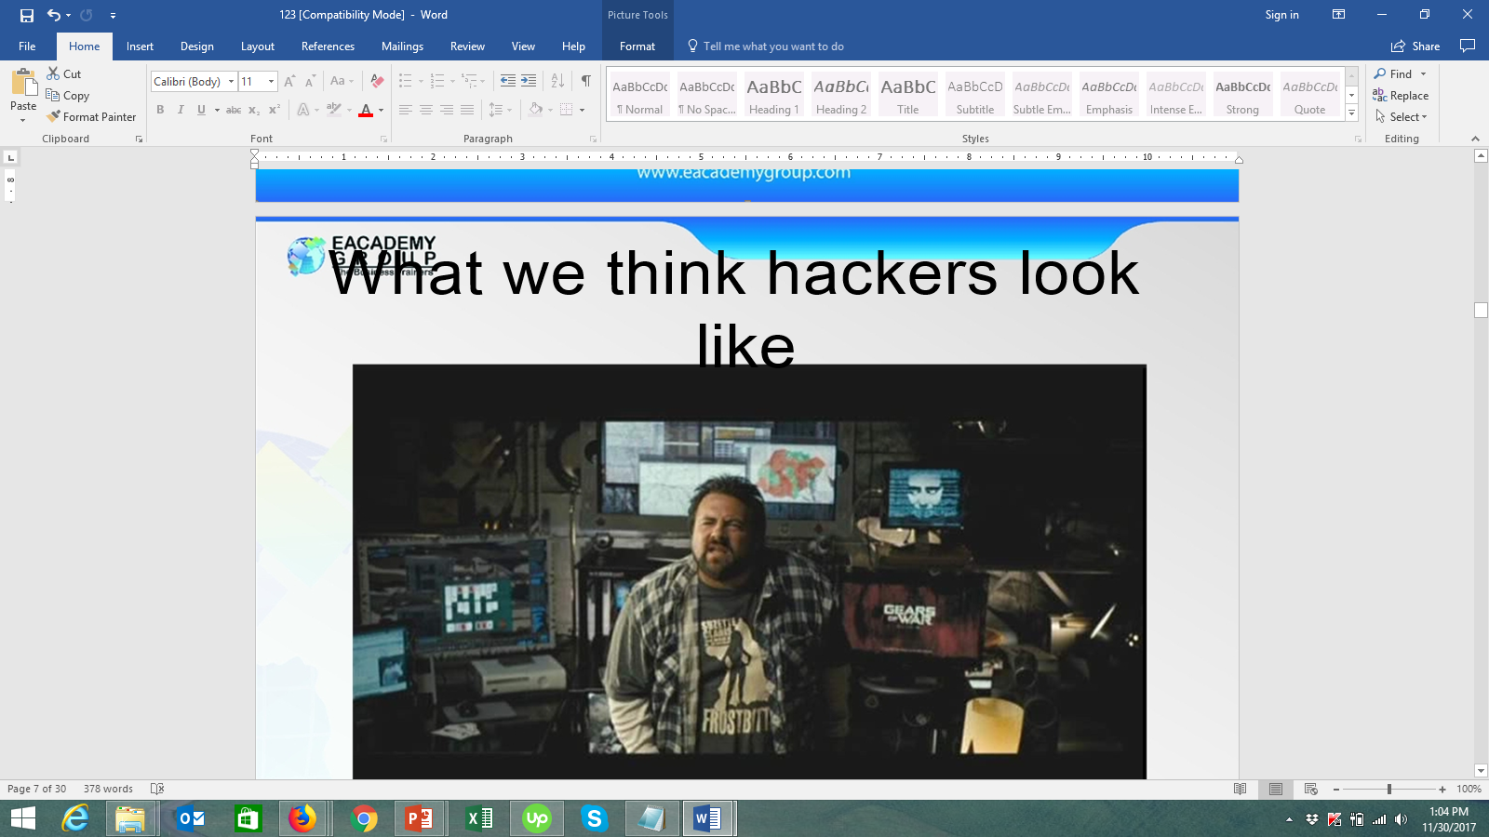
What we think hackers look like
Computer Fraud Overview cont…

Slide 29
Computer Fraud Overview cont…
(Report By BFID)
IMPACT OF EMBEZZLEMENT, LOAN
FRAUD & ONLINE BANKING FRAUD
THREE YEAR PERIOD, 2016, 2017 &
2018
BANKING FRAUD INVESTIGATION DEPARTMENT - CBK

Slide 30
Background of BFID;
Banking fraud investigation unit/Department (BFID) evolved from the former exchange control investigation unit upon the liberation of the economy in 1994.
At the same time there was general increase in fraud related cases which were reported from commercial banks, non-banking financial institutions and government departments for investigations.
This necessitated the formation of the unit to be based within the precinct of the regulator of commercial banks - CBK.
The members of BFID are drawn from the Directorate of Criminal Investigation complemented by a few support staff drawn from CBK.

Slide 31
Computer Fraud Overview cont…
Functions Of BFID
To receive and interrogate complaints from all banks, financial institutions, parastatals, government ministries and departments.
To inform and advice the financial industry on how to prevent and detect on
various types of frauds through periodic reports.
Sensitize the public on local regional and international on matters of financial crimes(money laundering, financing terrorisms).
Recovery of stolen funds and assets with view of restituting the same to the rightful owners through legal platform.
Liaison with other law enforcement agencies

Slide 32
Summary Report On Bank Fraud
Below are the status of banking fraud landscape
illustrated by cases reported in the three year period.
Year 2018;
Total cases reported -712
Cases forwarded to courts (PBC) -201
Cases Pending Arrest of Known Accused (PAKA) -197
Cases Pending Under Investigations (PUI) - 314
Number of persons charged before courts -271
Number of Cases Finalized in the year 2018 -256
Total Amount involved in the reported cases – KES 2,426,889,259.51
Total Amount recovered - KES 329,616,996.21
Total Amount lost to fraud - KES 2,097,272,263.30

Slide 33
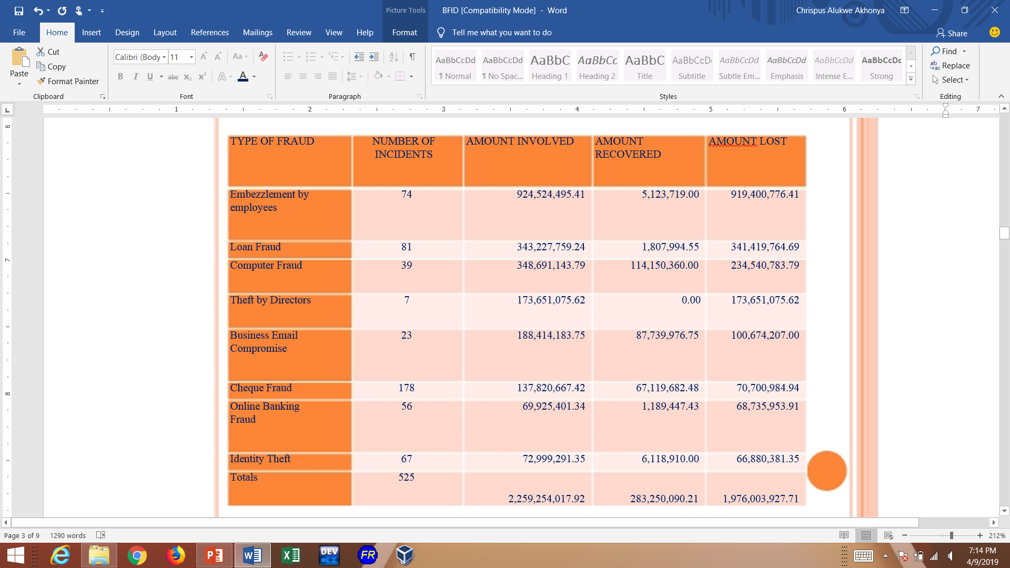
Summary Report On Bank Fraud
Below is a breakdown of Incidents where victims lost huge sums of money in 2018;

Slide 34
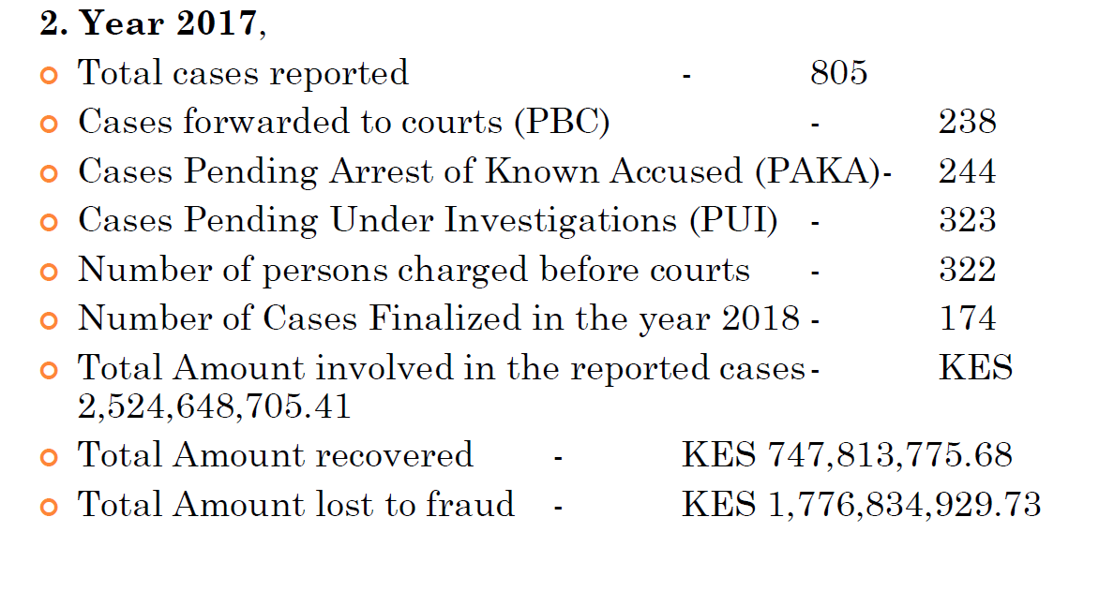
Summary Report On Bank Fraud
Cases on Identity Theft 2017

Slide 35
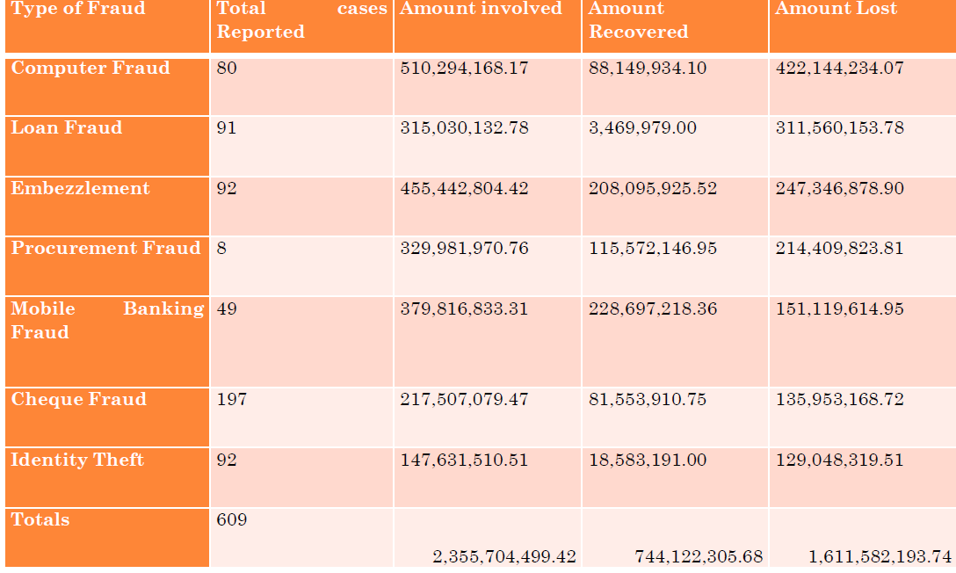
Summary Report On Bank Fraud
Break down of Theft 2017 Where Huge Amounts was Lost

Slide 36
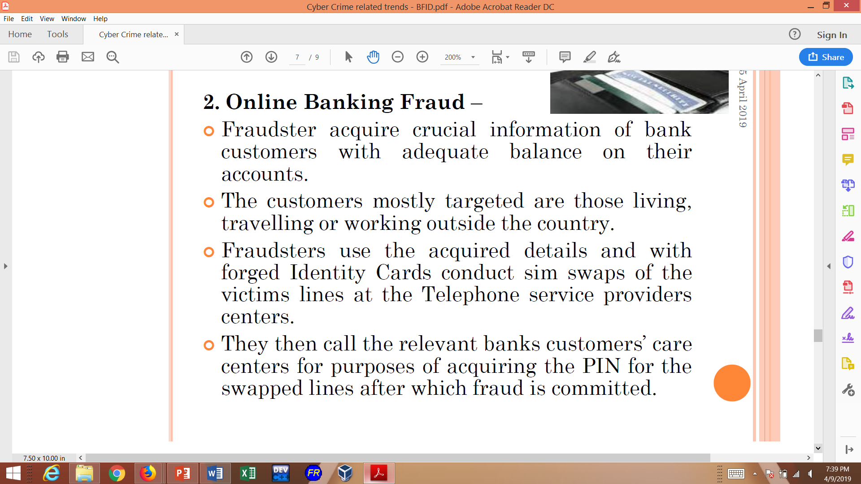

Slide 37
Computer Fraud: Classifications
Data
Fraud
Input
Fraud
Processor
Fraud
Output
Fraud
Computer
Instructions
Fraud
Notes:
Ch 5

Slide 38
Computer Fraud: Classifications
Processor Fraud
  Involves unauthorized system use
  Includes theft of computer time and services.
Notes:
Ch 5

Slide 39
Computer Fraud: Classifications
Computer Instructions Fraud
  Involves tampering with software that processes company data
  May include:
    Modifying the software
    Making illegal copies
    Using it in an unauthorized manner
Notes:
Ch 5

Slide 40
Computer Fraud: Classifications
Data Fraud
  Involves:
    Altering or damaging a company’s data files; or
    Copying, using, or searching the data files without authorization.
  Sale of stolen data
Notes:
Ch 5

Slide 41
Computer Fraud: Classifications
Output Fraud
  Stealing or misusing system output.
  Use computers and peripheral devices to create counterfeit outputs
Notes:
Ch 5

Slide 42
Computer Fraud and Abuse Techniques
Data diddling
Data leakage
Denial of service attacks
Eavesdropping
Email threats
Email forgery
Hacking
Phreaking
Hijacking
Identity theft
Notes:
Ch 5

Slide 43
Computer Fraud and Abuse Techniques
Internet misinformation
Internet terrorism
Logic time bombs
Masquerading or impersonation
Packet sniffers
Password cracking
Phishing
Piggybacking
Round-down technique
Salami technique
Notes:
Ch 5

Slide 44
Computer Fraud and Abuse Techniques
Social engineering
Software piracy
Spamming
Spyware
Keystroke loggers
Superzapping
Trap doors
Trojan horse
War dialing
War driving
Notes:
Ch 5

Slide 45
Computer Fraud and Abuse Techniques
Virus
Worms
The low-tech, do-it-yourself attack
Notes:
Ch 5

Slide 46
Deterring and Detecting Computer Fraud
Measures to decrease the potential for fraud and resulting losses:
  Make fraud less likely to occur
  Increase the difficulty of committing fraud
  Improve detection methods
  Reduce fraud losses
Notes:
Ch 5

Slide 47
Deterring and Detecting Computer Fraud
Make fraud less likely to occur
  Culture that stresses integrity
  Organizational structure, management philosophy, and operating style
  Independent audit committee
  Assign authority and responsibility
  Identify risky areas
  Develop a comprehensive set of security policies
  Implement human resource policies that send messages about ethical behavior and integrity
  Effectively supervise employees
Notes:
Ch 5

Slide 48
Deterring and Detecting
Computer Fraud
  Train employees in integrity and ethical considerations, as well as security and fraud prevention measures.
  Require annual employee vacations and periodic rotation of duties
  Implement project development and acquisition controls
  Prosecute fraud perpetrators more vigorously
Notes:
Ch 5

Slide 49
Deterring and Detecting Computer Fraud
Increase the difficulty of committing fraud
  Develop a strong system of internal controls
  Segregate the accounting functions of:
    Authorization
    Recording
    Custody
  Implement segregation of duties between systems functions
  Restrict physical and remote access to system resources
Notes:
Ch 5

Slide 50
Deterring and Detecting Computer Fraud
  Require authorization of transactions and activities
  Adequate design of documents and records
  Safeguard all assets, records, and data
  Require independent checks
  Implement computer-based controls
  Encryption of stored and transmitted data
  Install latest updates to software
Notes:
Ch 5

Slide 51
Deterring and Detecting Computer Fraud
Improve detection methods
  Create an audit trail
  Conduct periodic audits
  Install fraud detection software
  Implement a fraud hotline
  Employ a computer security officer
  Monitor system activities
  Use intrusion detection systems
Notes:
Ch 5

Slide 52
Deterring and Detecting Computer Fraud
Reduce Fraud Losses
  Maintain adequate insurance
  Develop comprehensive fraud contingency, disaster recovery, and business continuity plans
  Backup copies
  Monitor system activity
Notes:
Ch 5

Slide 53
Summary
We have:
  Defined fraud
  Described the Fraud Triangle (the fraud process)
  Discussed who perpetrates a fraud and why they do it, including:
    Pressures
    Opportunities
    Rationalizations
  Defined computer fraud
  Discussed computer fraud classifications
  Compared and contrasted the approaches and techniques used to commit computer fraud and sample case studies.
Notes:
Ch 5

Slide 54
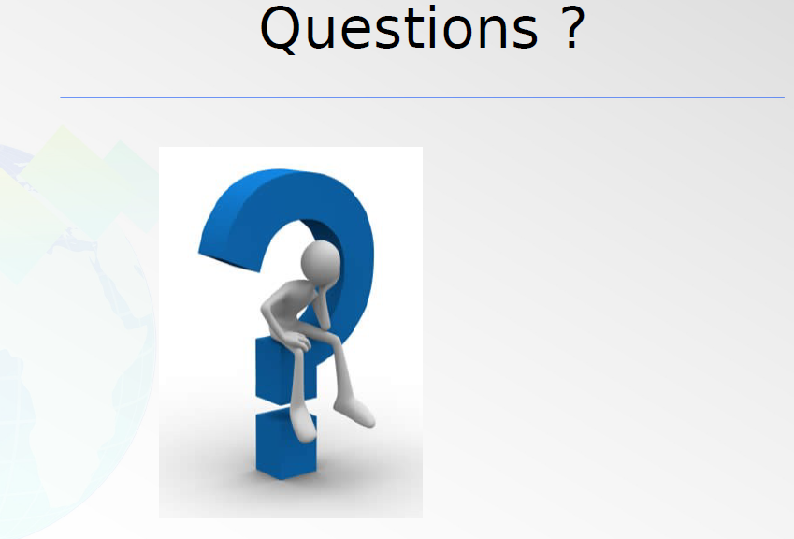

Slide 55
Performing a Risk Assessment
Lecture 4
Performing a Risk Assessment

Slide 56
Performing a Risk Assessment
As technology becomes more integral to the organization's operations and activities, a major challenge for internal auditors is how to handle companywide assessment of IT risks and controls within the scope of their overall assurance and consulting services.
Buffering……

